Slide 1

CHAPTER 7 Fraud, Internal Control, and Cash

Slide 2

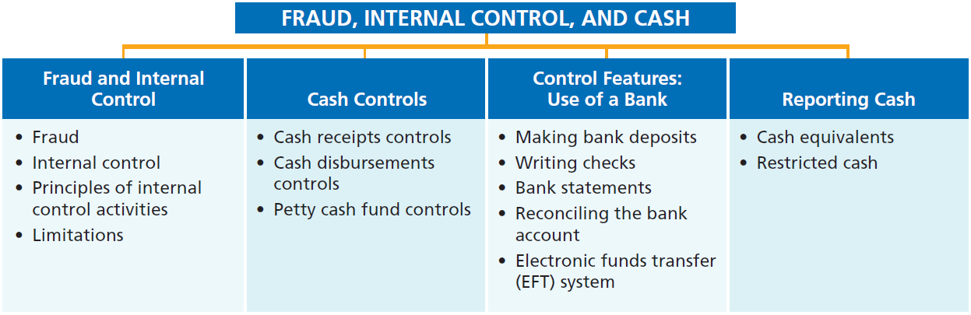
PREVIEW OF CHAPTER 7

Slide 3
Petty Cash Fund Controls
零用金控制
(See p.343)
Petty Cash Fund- Used to pay small amounts(小額付款).
Its operation(零用金作業)
Imprest system(預付制度)
Involve
Establishing the fund(設立零用金)
Making payments from the fund
Replenishing the fund(撥補零用金)

Slide 4
Establishing the Petty Cash Fund
設立零用金
(See p.344)
The amount in the fund covers anticipated disbursements (預計支出) for a three- to four-week period.
Illustration: If Zhu Ltd. decides to establish a NT$3,000 fund on March 1, the journal entry is:
Mar. 1
Petty Cash(零用金；A+) 3,000
Cash 3,000

Slide 5
Establishing the Petty Cash Fund
設立零用金
(See p.344)
A fixed-amount basis(固定金額基礎)
No additional entries to the “Petty Cash account” unless management changes the stipulated amount (規定金額)of the fund.
Illustration: If Zhu Ltd. decides to increase the size of the fund to NT$7,500 fund on July 1, the journal entry is:
July. 1
Petty Cash (零用金；A+) 4,500
Cash 4,500

Slide 6
Making Payments from Petty Cash
由零用金付款
(See p.344)
Management usually limits the size of expenditures.
Does not permit use of the fund for certain types of transactions.
Each payments are documented on a prenumbered petty cash receipt.(預先編號之零用金收據) 。
Signatures of both the custodian and the individual receiving payment (領款人).
Other supporting documents should be attached to the receipt.

Slide 7
Making Payments from Petty Cash
由零用金付款
(See p.344~5)
Custodian keeps the receipts in the petty cash box until the fund is replenished (撥補).
Sum of the receipts and money in the fund should equal the established total at all times.
Management should surprise count(突擊性盤點) at any time.
Accounting for payments from petty cash
No entry

Slide 8
Replenishing the Petty Cash Fund
撥補零用金
(See p.345)
The money in the petty cash fund reaches a minimum level.
Companies should replenish a petty cash fund at the end of the accounting year, regardless of the cash in the fund.
The custodian prepares a schedule or summary of the payment (付款清單或彙總表), supported by petty cash receipts and other documentation.
The treasurer(財務長) approve the request and issues a check to restore the fund to its established.

Slide 9
Replenishing the Petty Cash Fund
撥補零用金
(See p.345)
Accounting entry：
Miscellaneous Expense (雜項費用) (收據總額）
Cash over or short（現金短溢) (XXX)
Cash （設立金額與零用金金額之差額)
Cash over or short
Debit balance＝> Miscellaneous expense in the income statement
Credit balance ＝> Miscellaneous revenue in the income statement

Slide 10
Replenishing the Petty Cash Fund
撥補零用金
(See p.345)
Illustration: Assume that on March 15 Zhu’s petty cash custodian requests a check(請領支票) for NT$2,610. The fund contains NT$390 cash and petty cash receipts for postage NT$1,320, freight-out (運費) NT$1,140, and miscellaneous expenses(雜項費用) NT$150. The general journal entry to record the check is:
Mar. 15
Postage Expense 1,320
Freight-Out 1,140
Miscellaneous Expense 150
Cash 2,610

Slide 11
Replenishing the Petty Cash Fund
撥補零用金
(See p.345)
Illustration: The total of the cash plus receipts does not equal the established amount. The company need to recognize a cash shortage(短少) or overage( 溢出). Assume that Zhu’s petty cash custodian has only NT$360 in cash in the fund. Zhu would make the following entry:
Mar. 15
Postage Expense 1,320
Freight-Out 1,140
Miscellaneous Expense 150
Cash Over and Short 30
Cash 2,640

Slide 12
Replenishing the Petty Cash Fund
撥補零用金
(See p.345)
Illustration: The total of the cash plus receipts does not equal the established amount. Assume that Zhu’s petty cash custodian has only NT$420 in cash in the fund. Zhu would make the following entry:
Mar. 15
Postage Expense 1,320
Freight-Out 1,140
Miscellaneous Expense 150
Cash Over and Short 30
Cash 2,580

Slide 13
>
DO IT!
Bateer SA established a R$50 petty cash fund on July 1. On July 30, the fund had R$12 cash remaining(剩下現金) and petty cash receipts for postage R$14, office supplies R$10, and delivery expense R$15. Prepare journal entries to establish the fund on July 1 and to replenish the fund on July 30.(E7-7; E7-8; P7-2a)
July 1
Petty Cash 50
Cash 50
Postage Expense 14
Supplies 10
Delivery Expense 15
Cash Over and Short 1
Cash (R$50 – R$12) 38
July 30

Slide 14
Exercises : E7-7
(See p.366)
LaSalle SA established a petty cash fund on May 1, cashing a check for €100. The company reimbursed(撥補) the fund on June 1 and July 1 with the following results.
June 1: Cash in fund €1.75. Receipts: delivery expense €31.25; postage expense €41.00; and miscellaneous expense €25.00.
July 1: Cash in fund €3.25. Receipts: delivery expense €21.00; entertainment expense €53.00; and miscellaneous expense €24.75.
On July 10, LaSalle increased the fund from €100 to €150.
Instructions
Prepare journal entries for LaSalle SA for May 1, June 1, July 1, and July 10.

Slide 15
Exercises : E7-8
(See p.366)
Ankara A.S. uses an imprest petty cash system. The fund was established on March 1 with a balance of 100. During March, the following petty cash receipts were found in the petty cash box.
Date Receipt No. For Amount
3/5 1 Stamp Inventory 39
7 2 Freight-Out 17
9 3 Miscellaneous Expense 6
11 4 Travel Expense 24
14 5 Miscellaneous Expense 7
The fund was replenished(撥補) on March 15 when the fund contained 4 in cash. On March 20, the amount in the fund was increased to 150.
Instructions
Journalize the entries in March that pertain to(有關) the operation of the petty cash fund.

Slide 16
Control Features: Use of a Bank
(See p. 347)
Contributes to good internal control over cash.
Minimizes the amount of currency(貨幣) on hand.
Creates a double record of all bank transactions.
The asset account Cash maintained by the company should have the same balance as the bank’s Liability account for that company.
銀行存款調節表(Bank reconciliation) 的功能
分析公司帳載記錄與銀行記錄間差異金額與原因，如時間性差異或任何一方錯誤。

Slide 17
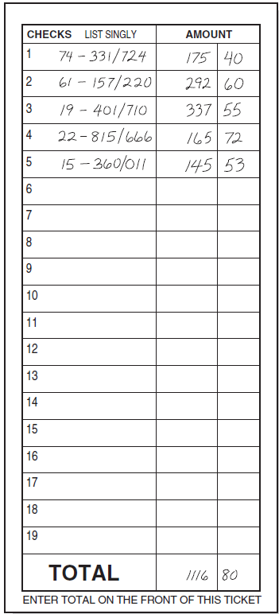
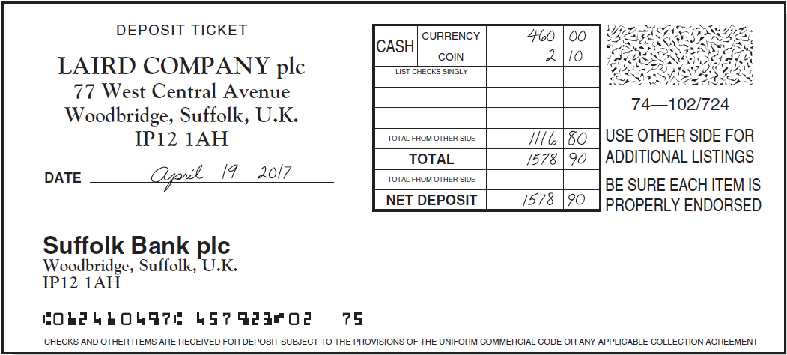
Making Bank Deposits處理銀行存款
(See p. 347)
Each deposit must be documented by deposit slip( ticket)(存款單(券)).
Illustration 7-8
Deposit slip
Bank Code Numbers
Front Side
Reverse Side

Slide 18
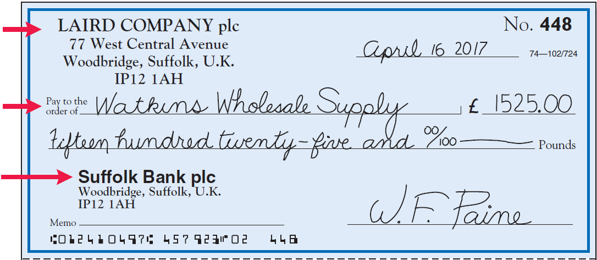
Writing Checks簽署支票
(See pp. 347~8)
Ａcheck is a written order signed by depositor directing bank to pay a specified sum of money to a designated recipient(受款人).
Illustration 7-9
Check with remittance advice
Maker
(發票人)
Payee
(受款人)
Payer
(付款人)

Slide 19
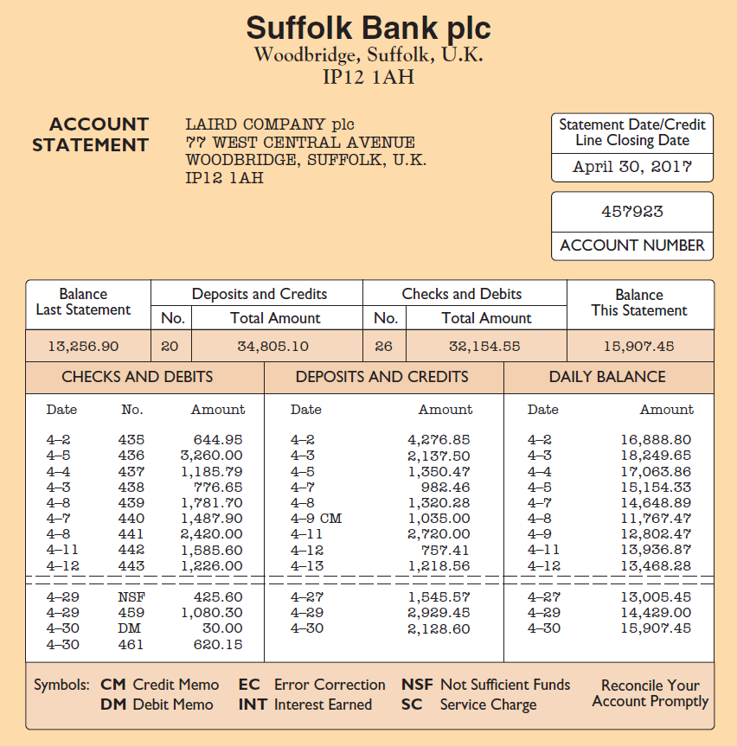
Bank Statements銀行對帳單
(See pp. 349)
Illustration 7-10 Bank statement

Slide 20
Bank Statements銀行對帳單
(See p. 349)
Debit memorandum(借項通知單)
Bank service charge(銀行服務費).
NSF (not sufficient funds; 存款不足退票)
Credit Memorandum(貸項通知單)
Collect notes receivable(代收應收票據)
Interest earned(已賺取之利息).

Slide 21
Reconciling the Bank Account
調節銀行帳戶
(See p.350)
Reconcile balance per books(公司帳載餘額)and balance per bank(銀行對帳單餘額)to their corrected cash balances (正確現金餘額).
Two causes of the difference:
Time lags(時間延遲)
Errors

Slide 22
Reconciliation Procedures調節程序
(See p.350)
Reconciling Items:
Deposits in transit(在途存款)
Outstanding checks(未兌現支票)
Bank memoranda(銀行通知單)
Errors
時間性差異
銀行未達帳
公司未達帳
銀行未達帳的補充說明
在途存款：公司已記存款增加，但銀行期末時因未收到此一款項而未入帳。
期末在途存款＝本期公司入帳的存款-[本期銀行入帳之公司存款-上期期末的在途存款]
未兌現支票：公司支票已開出且已記存款減少，但因持票人尚未持往銀行兌現，故銀行未入帳。
期末未兌現支票款＝本期公司帳上的現金支出總額-[本期銀行兌現本公司的支票─上期期末的未兌現支票款]
注意：計算時應先更正公司與銀行的存款記錄錯誤。

Slide 23
Reconciliation Procedures調節程序
(See p.351)
銀行存款調節表的補充說明(杜榮瑞，第六版)
銀行未達帳
通知銀行更正錯誤
銀行通知單
(公司未達帳，需作分錄）
(公司需作分錄）

Slide 24
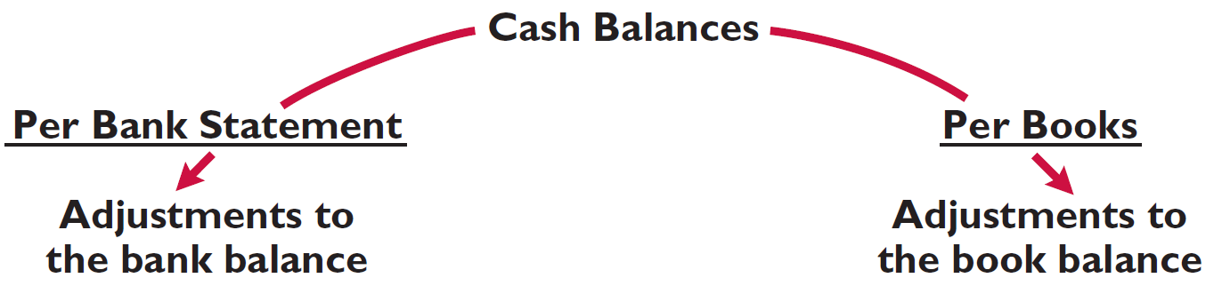
Reconciliation Procedures調節程序
(See p.351)
Illustration 7-11
Bank reconciliation adjustments
(銀行對帳單餘額)
(公司帳載 餘額)
+ Deposit in Transit
- Outstanding Checks
+/- Bank Errors
(在途存款)
+ Notes collected by bank
- NSF (bounced) checks
- Check printing or other service charges
+/- Book Errors
(銀行代收票據)
(未兌現支票)
(存款不足退票)
CORRECT BALANCE
CORRECT BALANCE

Slide 25
Bank Reconciliation Illustrated
(See p.351~2)
The bank statement for Laird Company, in Illustration 7-10, shows a balance per bank of £15,907.45 on April 30, 2017. On this date the balance of cash per books is £11,589.45. Using the four reconciliation steps, Laird determines the following reconciling items.
(B+)
Step 1. Deposits in transit:
April 30 deposit (received by bank on May 1). £2,201.40
Step 2. Outstanding checks: No. 453, £3,000.00; no. 457,
£1,401.30; no. 460, £1,502.70. 5,904.00
Step 3. Errors: Laird wrote check(簽發支票) no. 443
for £1,226.00 and the bank correctly paid that amount.
However, Laird recorded the check as £1,262.00. 36.00
Step 4. Bank memoranda:
a. Debit—NSF check from J. R. Baron for £425.60 425.60
b. Debit—Charge for printing company checks £30.00 30.00
c. Credit—Collection of note receivable for £1,000
plus interest earned £50, less bank collection fee £15.00 1,035.00
(B-)
(C+)
(C-)
(C-)
(C+)

Slide 26
Bank Reconciliation Illustrated
(See p.352)
Illustration: Prepare a bank reconciliation at April 30.
Cash balance per bank statement ₤15,907.45
Deposit in transit 2,201.40
Outstanding checks (5,904.00)
Adjusted cash balance per bank ₤12,204.85
(銀行帳調整後餘額)
Cash balance per books ₤11,589.45
Error in check No. 443 36.00
NSF check (425.60)
Bank service charge (30.00)
Collection of notes receivable 1,035.00
Adjusted cash balance per books ₤12,204.85
(公司帳調整後餘額)

Slide 27
Entries From Bank Reconciliation
(See p.352)
The company records each reconciling item used to determined the adjusted cash balance per books.
COLLECTION OF NOTE RECEIVABLE: Assuming interest of ₤50 has not been accrued and collection fee is charged to Miscellaneous Expense, the entry is:
Apr. 30
Cash (現金; A+) 1,035.00
Miscellaneous Expense(雜項費用; E+) 15.00
Notes Receivable(應收票據;A-) 1,000.00
Interest Revenue(利息收入; R+) 50.00

Slide 28
Entries From Bank Reconciliation
(See p.353)
BOOK ERROR: The cash disbursements journal (現金支出簿) shows that check no. 443 was a payment on account to Andrea Company, a supplier. The correcting entry is:
Apr. 30
Cash (A+) 36.00
Accounts Payable(應付帳款; L+) 36.00
NSF CHECK: As indicated earlier, an NSF check becomes an account receivable to the depositor. The entry is:
Apr. 30
Accounts Receivable(應收帳款;A+) 425.60
Cash(A-) 425.60

Slide 29
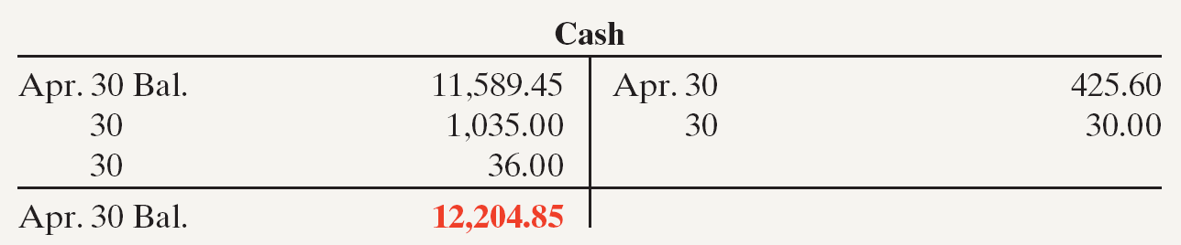
Entries From Bank Reconciliation
(See p.353)
BANK SERVICE CHARGES: Depositors debit check printing charges (DM) and other bank service charges (SC) to Miscellaneous Expense(雜項費用). The entry is:
Apr. 30
Miscellaneous Expense 30.00
Cash 30.00
Illustration 7-13 Adjusted balance in Cash account

Slide 30
Electronic Funds Transfer (EFT) System
電子資金轉帳系統
(See p.353)
Disbursement systems (付款系統)that use wire(電訊), telephone, or computers to transfer cash from one location to another.
Its use is quite common.
Normally result in better internal control since no cash or checks are handled by company employees.

Slide 31
>
DO IT!
(See p.354)
Sally Kist, owner of Linen Kist Fabrics, asks you to explain how she should treat the following reconciling items when reconciling the company’s bank account: (1) a debit memorandum for an NSF check, (2) a credit memorandum for a note collected by the bank, (3) outstanding checks, and (4) a deposit in transit.
Solution
Sally should treat the reconciling items as follows.
(1) NSF check: Deduct from balance per books.
(2) Collection of note: Add to balance per books.
(3) Outstanding checks: Deduct from balance per bank.
(4) Deposit in transit: Add to balance per bank.
(Related exercise material: E7-9~ E7-13; P7-3A~P7-5A)

Slide 32
Exercises : E7-10
On April 30, the bank reconciliation of Yazici Company shows three outstanding checks: no. 254, €650; no. 255, €720; and no. 257, €410. The May bank statement and the May cash payments journal show the following.
Instructions
Using Step 2 in the reconciliation procedure, list the outstanding checks at May 31.
 |  |  | Bank Statement |  |  |  |  |  |  |  |  | Cash Payments Journal
 | Checks Paid |  |  |  |  |  |  |  |  |  | Checks Issued
 | Date |  |  | Check No. |  |  | Amount |  |  |  | Date |  |  | Check No. |  | Amount
 | 5/4 |  |  | 254 |  |  | 650 |  |  |  | 5/2 |  |  | 258 |  | 159
 | 5/2 |  |  | 257 |  |  | 410 |  |  |  | 5/5 |  |  | 259 |  | 275
 | 5/17 |  |  | 258 |  |  | 159 |  |  |  | 5/10 |  |  | 260 |  | 820
 | 5/12 |  |  | 259 |  |  | 275 |  |  |  | 5/15 |  |  | 261 |  | 500
 | 5/20 |  |  | 261 |  |  | 500 |  |  |  | 5/22 |  |  | 262 |  | 750
 | 5/29 |  |  | 263 |  |  | 480 |  |  |  | 5/24 |  |  | 263 |  | 480
 | 5/30 |  |  | 264 |  |  | 560 |  |  |  | 5/29 |  |  | 264 |  | 560

Slide 33
Exercises : E7-11
The following information pertains to Teresina Video SA.
1. Cash balance per bank, July 31, R$7,293.
2. July bank service charge not recorded by the depositor R$28.
3. Cash balance per books, July 31, R$7,427.
4. Deposits in transit, July 31, R$1,500.
5. Bank collected R$700 note for Teresina in July, plus interest R$356, less fee R$25. The collection has not been recorded by Teresina, and no interest has been accrued.
6. Outstanding checks, July 31, R$684.
Instructions
(a) Prepare a bank reconciliation at July 31.
(b) Journalize the adjusting entries at July 31 on the books of Teresina Video SA.

Slide 34
Exercises : P7-3B
(See p.373)
Aglife Genetics Ltd. of Lancaster, Wisconsin, spreads herbicides and applies liquid fertilizer for local farmers. On May 31, 2017, the company‘s Cash account per its general ledger(總分類帳) showed the following balance.
CASH NO. 101
Date | Explanation | Ref. | Debit | Credit | Balance
May 31 | Balance |  |  |  | 13,287
The bank statement from Lancaster State Bank on that date showed the following balance.
Checks and Debits |  | Lancaster Bank Deposits and Credits |  | Daily Balance
XXX |  | XXX |  | 5/31 12,648
A comparison of the details on the bank statement with the details in the Cash account revealed the following facts.

Slide 35
Exercises : P7-3B (Continued)
1. The statement included a debit memo of £35 for the printing of additional company checks. (C-)
2. Cash sales of £1,720 on May 12 were deposited in the bank. The cash receipts journal entry and the deposit slip were incorrectly made for £1,820. The bank credited Aglife Genetics for the correct amount.(C-)
3. Outstanding checks at May 31 totaled £1,425(B-), and deposits in transit were £2,100 (B+).
4. On May 18, the company issued check no. 1181 for £1,102 to M. Datz on account. The check, which cleared the bank(銀行付訖) in May, was incorrectly journalized and posted by Aglife Genetics for £110(C-).
5. A £4,000 note receivable was collected by the bank for Aglife Genetics on May 31 plus £100 interest. The bank charged a collection fee of £25. No interest has been accrued on the note.(C+)

Slide 36
Exercises : P7-3B(Continued)
6. Included with the cancelled checks(註銷支票) was a check issued by River Lune Company to Carol Mertz for £900 that was incorrectly charged to Aglife Genetics by the bank.(B+)
7. On May 31, the bank statement showed an NSF charge of £2,012 for a check issued by Tyler Gricius, a customer, to Aglife Genetics on account.(C-)
Instructions
Prepare the bank reconciliation at May 31, 2017.
Prepare the necessary adjusting entries for Aglife Genetics Company at May 31, 2017.

Slide 37
Reporting Cash
(See p.354~5)
Cash consists of coins, currency(貨幣), checks(支票),
money orders(匯票), and money on hand or on deposit.
Statement of financial position reports the amount of cash available (可用現金金額)at a given point in time.
Listed first in the current assets section.
Includes cash on hand(庫存現金), cash in banks(銀行存款), and petty cash(零用金).
Statement of cash flows shows the sources and uses of cash during a period of time.

Slide 38
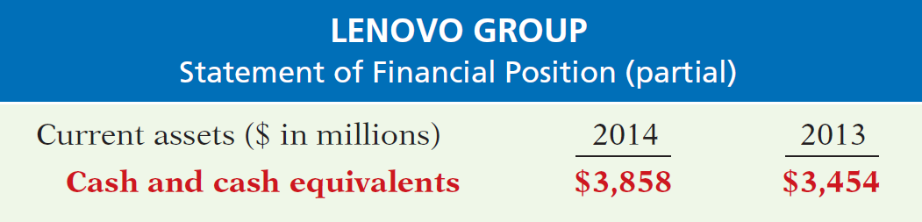
Cash Equivalents約當現金
(See p.355)
Cash equivalents are short-term, highly liquid investments that are both:
1.Readily convertible to known amounts of cash(能立即轉換 成已知的現金數額)
2. So near their maturity that their market value is relatively insensitive to changes in interest rates.
Illustration 7-14
Statement of financial position presentation of cash

Slide 39
Restricted Cash受限制的現金
(See p.355)
Cash that is not available for general use but rather is restricted for a special purpose.
If the company expects to use the restricted cash within (after) the next year, it reports the amount as a current (non-current) asset.

Slide 40
>
DO IT!
Indicate whether each of the following statements is true or false.
Cash and cash equivalents are comprised of coins, currency (paper money), money orders, and NSF checks.
Restricted cash is classified as either a current asset or noncurrent asset, depending on the circumstances.
A company may have a negative balance in its bank account. In this case, it should offset this negative balance against cash and cash equivalents on the statement of financial position.
Because cash and cash equivalents often includes short-term investments, accounts receivable should be reported as the last item on the statement of financial position.
False
True
False
False

